Slide 1


IOT-Based- Health & Posture Monitoring System
Chen Einy-209533785 Bar Nahmuka-205386899

Slide 2
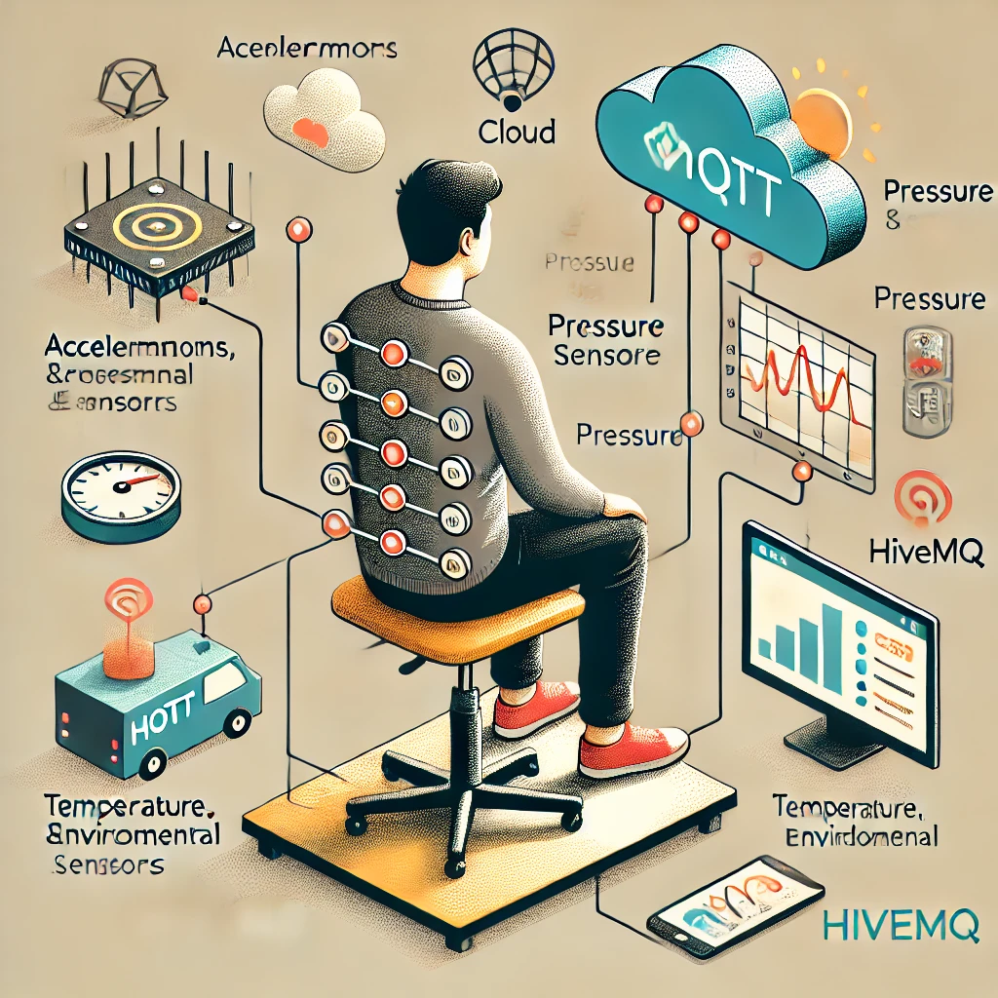
Introduction
The idea of the project we chose is an IoT-Based Health and Posture Monitoring System. This system monitors posture and environmental conditions in real-time using sensors like pressure sensors, accelerometers, and temperature/humidity sensors. The project is designed to collect data via MQTT, display relevant information in the GUI, and store it in a local/cloud database. The system also sends warnings or alerts for poor posture or uncomfortable environmental conditions, and it allows users to publish and subscribe to topics dynamically.

Slide 3

System Description
The system consists of several modules:
1. Emulators: Simulates sensor data such as tilt values from accelerometers and pressure from the seat. 2. Data Manager: Collects, processes, and logs the data received from the sensors. 3. GUI: Provides a user interface for real-time data display, connection management, and alert handling. 4. Database: Stores sensor data and events for further analysis or historical reference.

Slide 4
Project Goals:
Monitor Posture: Use pressure and accelerometer sensors to detect improper posture.
Monitor Environment: Use temperature and humidity sensors to ensure comfort.
Alerts: Provide real-time alerts if the user has poor posture or if the environmental conditions are not suitable.
Data Storage: Store all incoming sensor data in a local or cloud-based database for historical records.
MQTT Communication: Enable seamless communication between sensors and the GUI using MQTT.

Slide 5
Stakeholders:
End Users (Individuals): These are people who would directly use the system to monitor their posture and environmental conditions. They might include office workers, students, or individuals working from home who want to maintain good posture and ensure a comfortable environment.
Healthcare Professionals: Physical therapists, ergonomists, or doctors might use the system to monitor patients remotely, providing insights into posture habits that could lead to musculoskeletal issues.
Employers or Office Managers: In a corporate or office setting, employers could use this system to help monitor and ensure their employees maintain proper posture during long working hours, thus preventing posture-related health issues.
Researchers: People involved in ergonomics or health monitoring research may use the system to collect and analyze data on posture and environmental factors over time for various studies or projects.

Slide 6
Functional Requirements:
Real-time Posture Monitoring: The system should continuously collect data from the pressure and accelerometer sensors and alert users when poor posture is detected.
Environmental Monitoring: The system should display real-time temperature and humidity data and notify users of discomfort.
Data Collection: All data from the sensors should be stored in the database without overwriting previous entries.
MQTT Communication: The system should support publishing and subscribing to MQTT topics for efficient data exchange.
Alerts: The system should trigger alerts based on preset thresholds (for posture, temperature, and humidity).

Slide 7
Non-Functional Requirements:
Scalability: The system should be able to accommodate additional sensor types or emulators in the future.
Reliability: The posture and environment monitoring functions should operate with minimal downtime and high accuracy.
Performance: The system should process and display sensor data with minimal delay.
Security: MQTT communication should be secure, with proper authentication where required.

Slide 8
Project Design:
The system is designed using a modular approach, with separate components handling:
Data Acquisition (Emulators): Each emulator simulates data and sends it via MQTT.
Data Management: A module responsible for collecting, processing, and storing data in the database.
GUI: A graphical interface that connects to the broker, subscribes to relevant topics, and presents real-time data and alerts to the user.
Alerts Mechanism: Alerts are generated based on the analysis of the data, particularly for posture and environmental conditions.

Slide 9
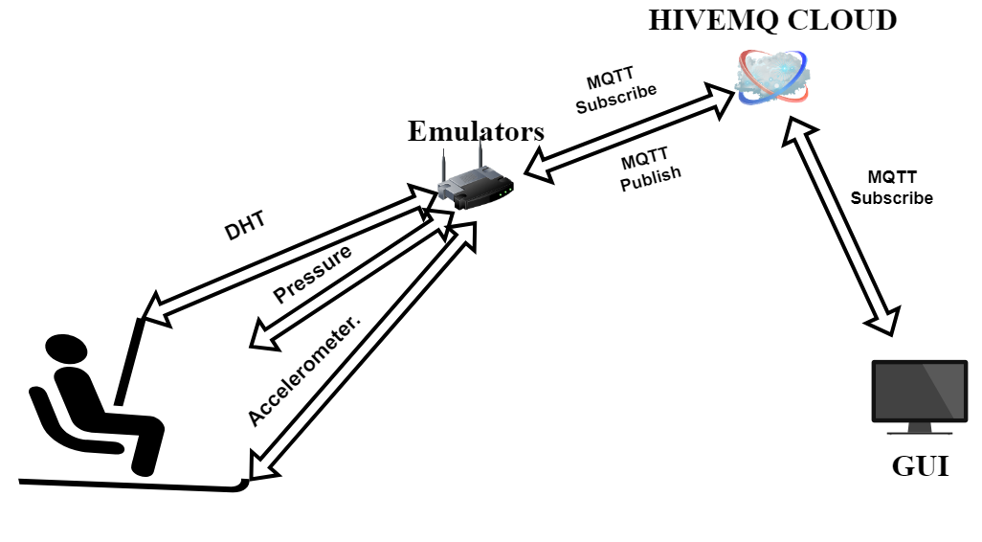
Project Design & Structure:

Slide 10
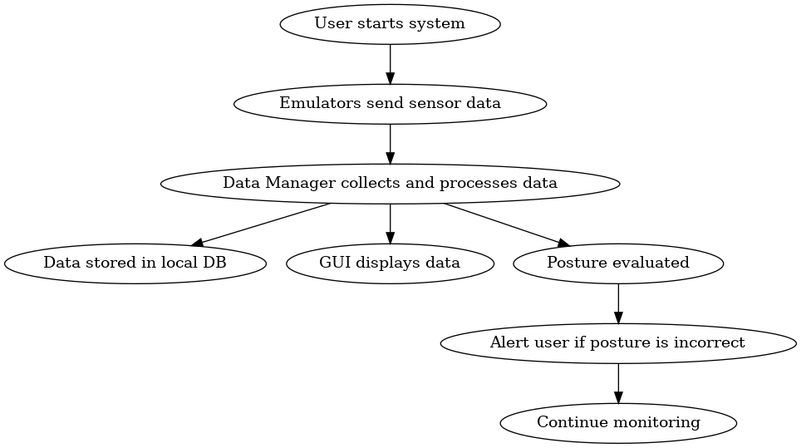
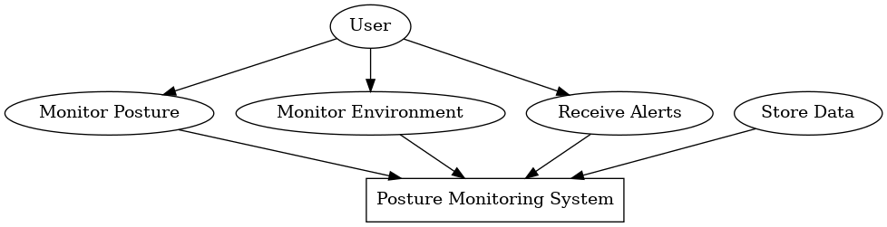
Development Diagrams:
Use case Diagram
Activity Diagram:

Slide 11
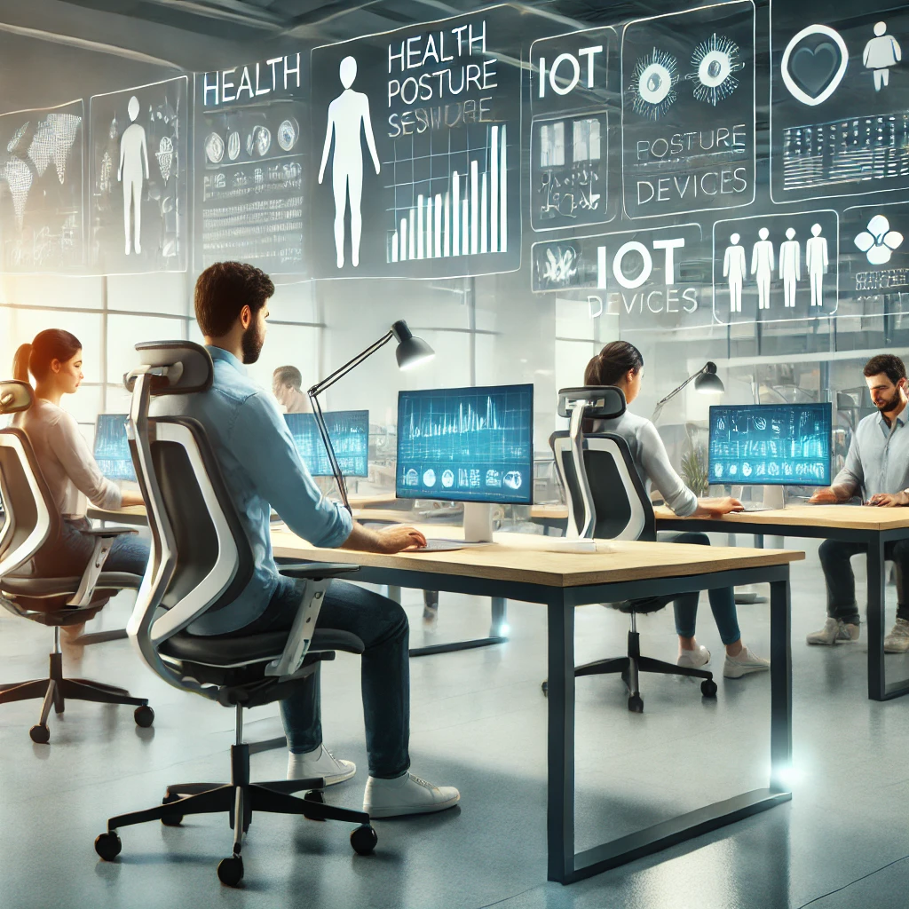
Future work & Improvement:
AI-Driven Posture Correction: Integrate AI or machine learning algorithms to detect more complex posture patterns and provide personalized posture correction tips.
Wearable Integration: Expand the system to integrate with wearable devices (smartwatches, posture correctors) for more accurate real-time monitoring.
Real-Time Feedback: Add real-time vibration feedback or audio alerts for immediate posture correction.

Slide 12
Link to Github:
https://github.com/ChenEiny/IOT_Posture_and_Monitoring_System
https://github.com/BarNahmuka/IOT_Posture_and_Monitoring_System

